Slide 1

ENGINEERING CHEMISTRY
Asha A
Department of Science and Humanities

Slide 2

ENGINEERING CHEMISTRY
Module 5- Energy storage devices – Supercapacitors
Class content:
Supercapacitors
Principle
Construction and working
Advantages
Disadvantages
Applications
Ragone Plot

Slide 3
ENGINEERING CHEMISTRY
Module 5- Energy Storage devices- Fuel cells
Alkaline fuel cells
Aqueous solution of KOH is used as electrolyte
Low temperature fuel cell (operates at 100ºC)
Oxygen reduction is more rapid in alkaline electrolytes
than in acid electrolytes
Use of non noble metal electro-catalyst is feasible
Carbon containing fuels cannot be used as CO₂ is
formed as product which reacts with the electrolyte, KOH, to form K₂CO₃ which reduces efficiency of the cell
CO₂ + KOH → K₂CO₃ + H₂O

Slide 4
ENGINEERING CHEMISTRY
Module 5- Energy Storage devices- Fuel cells
Construction :
Anode : Porous carbon impregnated with Pt catalyst
Cathode : Porous carbon impregnated with Ag catalyst
Fuel : Hydrogen gas
Oxidant : Oxygen gas
Electrolyte : 30-45 % KOH(warm)

Slide 5
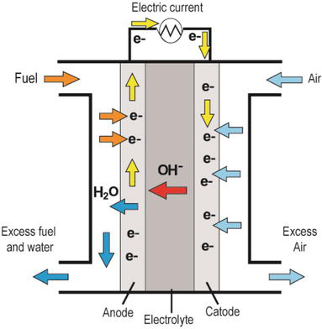
ENGINEERING CHEMISTRY
Module 5- Energy Storage devices- Fuel cells
Cell representation:
H₂|Pt|KOH|Ag|O₂
Source:https://www.intechopen.com/books/new-trends-in-ion-exchange-studies/hydroxide-transport-in-anion-exchange-membranes-for-alkaline-fuel-cells

Slide 6
ENGINEERING CHEMISTRY
Module 5- Energy Storage devices- Fuel cells
Working:
H₂ gas diffuses through anode, gets adsorbed on the electrode surface ,reacts with OH- to form water
At cathode O₂ diffuses through electrode, is adsorbed and reduced to OH-
Product is water which dilutes the KOH
Cell operates at 100ºC, so that water from KOH escapes as steam
The water was used by astronauts for drinking on Apollo spacecraft
Emf = 1.23 V

Slide 7
ENGINEERING CHEMISTRY
Module 5- Energy Storage devices- Fuel cells
Advantages:
Operates at low temperature
Alkali is used as electrolyte hence non noble metal catalyst can
be used so less expensive
Disadvantages:
Reactants must be free from C, because on oxidation CO₂ is formed .The alkali reacts with CO₂ to form carbonates which reduce efficiency of the cells; pure fuel and oxidant which are free of carbon compounds must be used
Liquid electrolytes pose handling problems

Slide 8
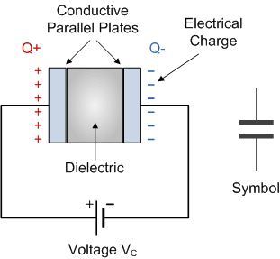
ENGINEERING CHEMISTRY
Module 5- Energy Storage devices- Supercapacitors
Capacitor
A two- terminal electrical component that has the ability to store energy in the form of electrical charge
Has two conducting plates separated by a dielectric
When a DC voltage is connected across the capacitor, one plate becomes positive and the other negative
The charge accumulation on the plates causes a voltage or potential
difference across the capacitor
Source:https://www.electronics-tutorials.ws/capacitor/cap_1.html

Slide 9

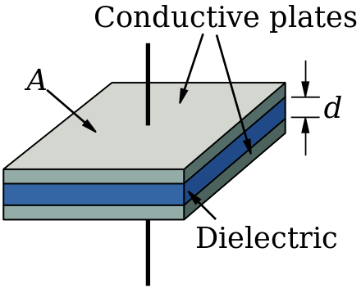
ENGINEERING CHEMISTRY
Module 5- Energy Storage devices- Supercapacitors
Capacitance is the charge accumulation capability of a capacitor
Charge (Q) stored in a capacitor is directly proportional to the voltage
(V) developed across the capacitor;
Q = C × V, where C is the capacitance measured in farads
Capacitance is directly proportional to area of plates (A) and inversely
proportional to the distance between the two plates (D);
Source:https://www.wikiwand.com/en/Capacitor_types

Slide 10
ENGINEERING CHEMISTRY
Module 5- Energy Storage devices- Supercapacitors
Supercapacitors
Also known as ultra capacitors or electrochemical double-layer capacitors(EDLC)
Are energy storage devices that have high capacitance and are used to
store large amounts of electrical charge
Charge and discharge very quickly
Capacitance is several thousand times that of a Capacitor
Capacitor ----- µF
Supercapacitor ----- thousands of Farads

Slide 11
ENGINEERING CHEMISTRY
Module 5- Energy Storage devices- Supercapacitors
Construction:
Electrodes: made of high surface area materials such as porous carbon, graphene, carbon nanotubes and certain conducting polymers or carbon aerogel
Electrolyte: KOH, H₂SO₄, Na₂SO₄
Separator: an ion permeable separator is placed between the electrodes in order prevent electrical contact, but still allows ions from electrolyte to pass through e.g., porous polypropylene

Slide 12
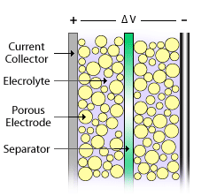
ENGINEERING CHEMISTRY
Module 5- Energy Storage devices- Supercapacitors
Separator is sandwiched between the electrodes
This is placed into a case , impregnated with electrolyte and sealed
The electrodes are flanked with current collectors
Source:https://www.azonano.com/article.aspx?ArticleID=3044

Slide 13
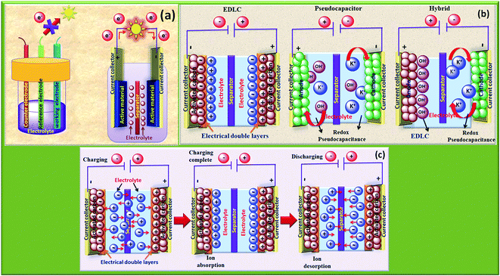
ENGINEERING CHEMISTRY
Module 5- Energy Storage devices- Supercapacitors
Working:
When a potential is applied, the positive electrode attracts negative ions in the electrolyte, while negative electrode attracts the positive ions
Formation of electrical double layer at entire electrode /electrolyte interface with a charge separation in nanometer scale
Source:https://pubs.rsc.org/en/content/articlelanding/2019/na/c9na00374f#!divAbstract

Slide 14
ENGINEERING CHEMISTRY
Module 5- Energy Storage devices- Supercapacitors
Only absorption and desorption of ions takes place at the electrode during charging and discharging and there are no redox reactions
Distance between the charged layers in nanorange, d is very small and use of porous electrodes gives very high surface area , A is large
; Capacitance is very high
Formation of the electrical double-layer at each electrode/electrolyte interface, overall capacitance (C_{T}) is expressed as:
where C₊ is the capacitance of cathode/electrolyte interface and C₋ is the capacitance of anode/electrolyte interface

Slide 15
ENGINEERING CHEMISTRY
Module 5- Energy Storage devices- Supercapacitors
Advantages:
Rapid charging; charge in a few seconds
High power density as they discharge very fast
High cycle life, can be cycled millions of time
Safe as extremely low internal resistance and extremely low heating rates

Slide 16
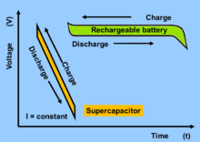
ENGINEERING CHEMISTRY
Module 5- Energy Storage devices- Supercapacitors
Disadvantages:
Low energy density
High self discharge
Linear discharge voltage
High cost
Power available for a short duration
Source:https://store.chipkin.com/articles/beyond-the-lithium-ion-battery-a-look-at-supercapacitors-and-other-batteries

Slide 17
ENGINEERING CHEMISTRY
Module 5- Energy Storage devices- Supercapacitors
Applications:
Memory back-up
Hybrid cars for start-stop application
Flash photography devices in digital cameras, flash lights,
portable media players
As an intermediate energy storage for FM radios, cell
phones, and emergency kits

Slide 18
ENGINEERING CHEMISTRY
Module 5- Energy Storage devices- Supercapacitors
Ragone Plot
Energy density (Wh/kg) is plotted against Power density (W/kg)
To compare performance of various energy storage devices
Since it uses a double-logarithmic chart, storage technologies with
very different storage properties can be compared in one plot

Slide 19
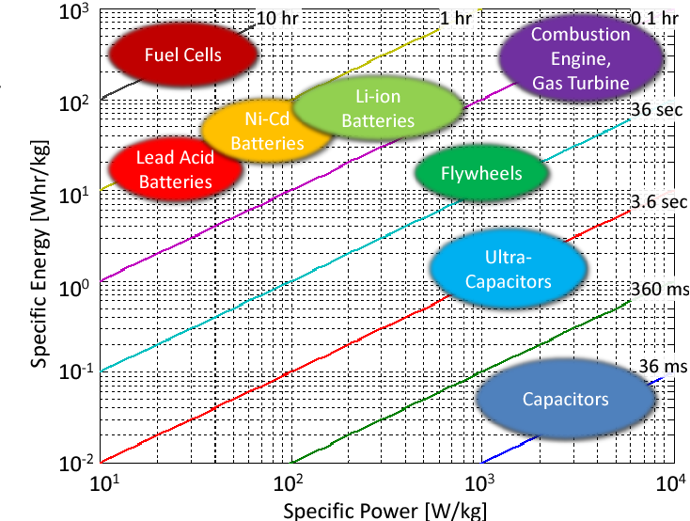
ENGINEERING CHEMISTRY
Module 5- Energy Storage devices- Supercapacitors
Source:https://www.semanticscholar.org/paper/Education-on-vehicle-electrification%3A-Battery-Fuel-Moura-Siegel/7e83f03396b55f2a894461480dda7e9c154f5721/figure/0

Slide 20
ENGINEERING CHEMISTRY
Module 5- Energy Storage devices- Supercapacitors
Fuel cells have high energy density as the electroactive species can be continuously supplied but the power density is low due to slow kinetics of redox reactions at electrodes
Battery systems offer moderate energy density and power density.
Ultracapacitors (supercapacitors) can deliver very high power density as they can discharge a large amount of charge quickly (because no redox reaction is involved) but energy density is very limited because the charge cannot be stored for a long time

Slide 21
THANK YOU
Asha A
Department of Science and Humanities

